Slide 1

TI-RSLK: TI Robotic Systems Learning Kit
Introduction and Overview

Slide 2
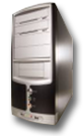
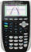
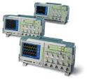
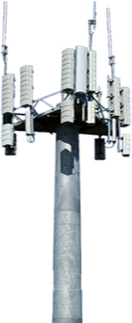
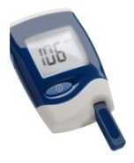
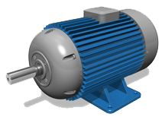

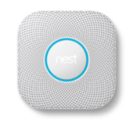

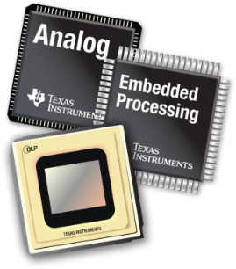

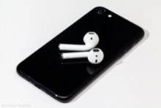
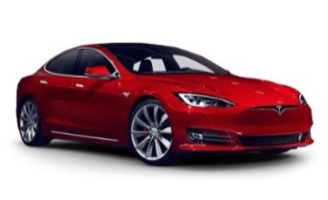
Who is TI? You use TI circuits every day!
100,000+ products, focused on Analog and Embedded Processing
100,000+ customers!
Revenue:
67% Analog: Power, Sensors…
23% Embedded Processing
10% Other: Calculators, IP…
Notes:
Goal: Introduce TI as a semiconductor supplier with a diversified customer base – not just invested in one market
Suggested text:
You’re probably familiar with Texas Instruments – we’ve likely spoken with each of you in the past about our various product announcements. TI’s broad product portfolio of analog and embedded processing products are used in a variety of markets – the top three being Industrial (35%), Personal Electronics (25%) and Automotive (19%), which more than three quarters of TI’s annual revenue is generated.
It should be no surprise that TI has a history in the industrial market – our legacy can be traced back to the energy exploration market almost 90 years ago. Since that time, TI has applied it’s knowledge and expertise to build robust and reliable semiconductor products in other markets –Automotive being one of them.
Optional text:
Industrial covers a broad set of sectors – ranging from building and factory automation – to medical, grid infrastructure and appliances.
Personal electronics includes non-medical wearable devices, tablets, personal computers, notebook computers and audio devices
Communication equipment ranges from enterprise switching, telecom infrastructure and wireless infrastructure.
Enterprise Systems cover servers – and projectors enabled by TI’s DLP® display technology.
Finally, we come to the main topic for today – Automotive. But this isn’t just about automotive-qualified PRODUCTS... TI’s commitment is to support its customers from a SYSTEMS-based approach.
Let me tell you what that means on the next slide... [block diagram slide]

Slide 3


TI makes ICs... So Engineers can make systems…
TI Part Number Examples
Sense something:
Get it into the Processor, Do something, Get it out…
Drive (or talk to) something else:
TPDxxxx
LDCxxxx
REFxxxx
MUXxxxx
DSxxxx
Magnetic Field change
Inductance
Sensor/Converter
Voltage Reference (for Analog Input)
Display Driver
(DLP, HDMI, DP…)
Displays
OPAxxxx
ADCxxxx
Clock
Generator(s)
LMKxxxx
Electric
Field change
Capacitance
Sensor/Converter
FDCxxxx
Analog Signal
Amplify/
Filter
Analog to
Digital Converter
Speaker Driver
(Headphones…)
LMxxxx
Speakers
Digital
Signal
SN74xxxx
Optical-based
Distance Sensor
OPT3101
Logic/Gates
DRVxxxx
Distance
Motor Driver
(Vehicles, fans…)
Motors
Digital Signals
Processing
Digital Signals
Optical
Light Sensor
OPTxxxx
“Big” Processor:
FPGA, GPU, CPU
Embedded Processor:
MCU: MSP43x/LaunchPad
MPU: Sitara/BeagleBone
DSP: C6000/LCDK
LED Driver (Backlight, RGB…)
LPxxxx
Brightness
MSP43x
Lights
Mux/Expand, Switch, Convert, Level Translate…
BeagleBone
Electro-Static Discharge (ESD) Protection
Mux/Expand, Switch, Convert, Level Translate…
TMPxxxx
Electro-Static Discharge (ESD) Protection
Temperature
Sensor
OMAP, Cxxx
Bluetooth chip
CC26xx
Temperature
Bluetooth
Digital
Signal
DACxxxx
OPAxxxx
Humidity
Sensor
HDCxxxx
Digital to Analog Converter
Wi-Fi chip
CC3xxx
Humidity
Amplify/
Filter
Analog Signal
Wi-Fi
Optical or Radar
3D Mapping Sensor
IWRxxxx
REFxxxx
Computing
(PCIe, LVDS…)
PCIxxxx
High Speed Interfaces
3D Map
Voltage Reference (for Analog Output)
Pulse, EKG, Temp, etc.
Medical Analog
Front End
AFExxxx
Busses
(SPI/I2C/CAN…)
DSxxxx
Low Speed Interfaces
Power for every item on this page!
TPSxxxx
MUXxxxx
DC to DC Voltage Regulators
Many Types: Switching/Linear/Modules
TPDxxxx
UCC2xxx
LMxxxx
TPSxxxx
BQxxxx
Cord
AC to DC
Protection
Protection
Battery
Charge/Gauge
Battery

Slide 4
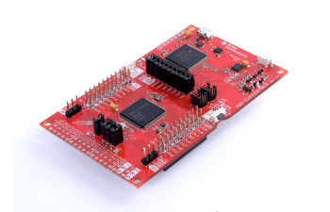
Meet the TI LaunchPad microcontroller kit
The MSP432P401R microcontroller, brain of the TI-RSLK
Program & control over USB
Exposed socket and header pins to interface with the physical world!
INPUTS & OUTPUTS
“Quick start” LEDs & buttons

Slide 5
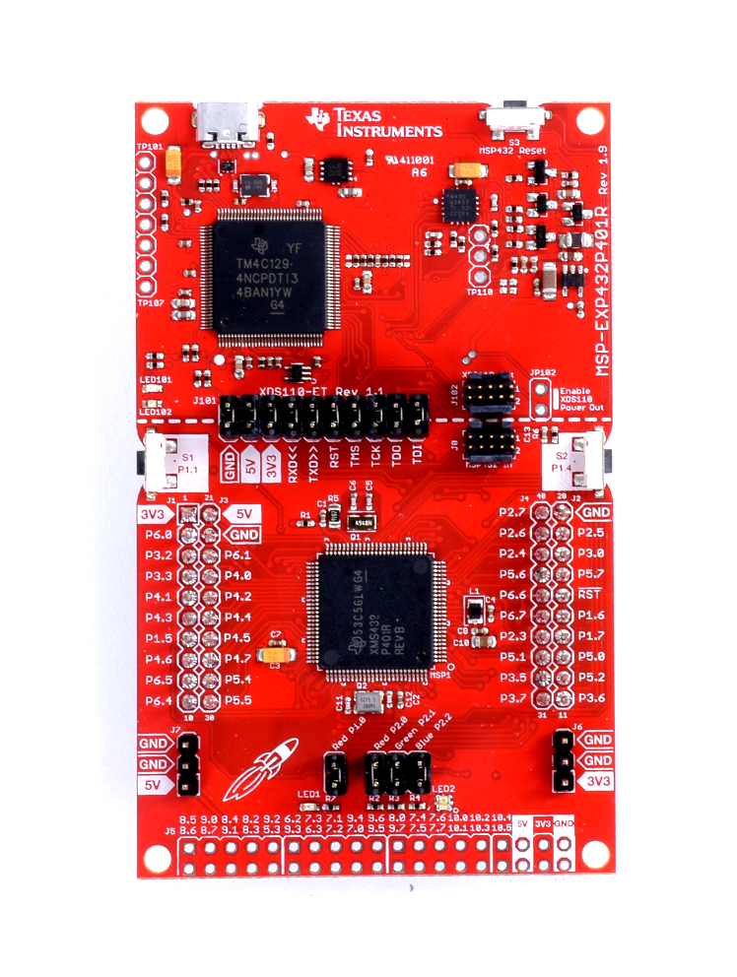
MSP432 LaunchPad
Introducing the SimpleLink MSP432 processor for Low Power + Performance
Target MCU: MSP432P401R
BoosterPack Pinout: 40-pin
Specs:
48 MHz 32-bit ARM® Cortex™-M4F CPU
256 kB Flash / 64 kB RAM
14-bit 1MSPS SAR ADC, Timers, AES Accelerator, I2C, UART, SPI
Why this LaunchPad?
EnergyTrace+ to measure system current
Good performance balance & great for general purpose applications
$12.99
MSP-EXP432P401R

Slide 6
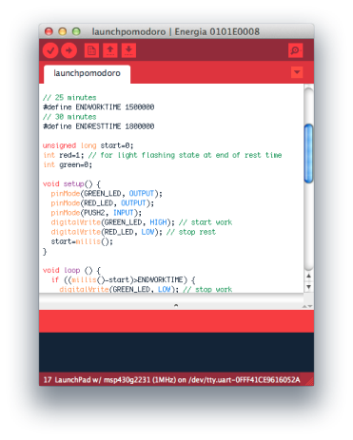
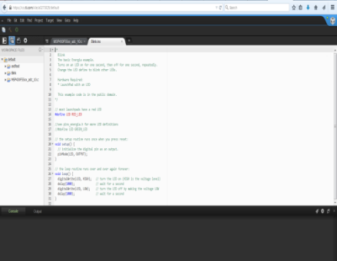
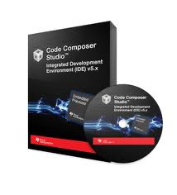



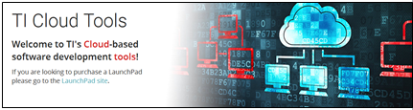



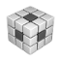


LaunchPad Software Tools - providing multiple points of entry
Intuitive & flexible software development paths speed up firmware creation for rapid prototyping
Rapid Prototyping
Evaluation
Advanced
Energia
Light-weight, Community-driven, Wiring-based IDE for quick evaluation
CCS Cloud
Browser-based code editor and Resource Explorer
CCS & Pro Tools
Fully-capable dev environments from TI & third parties
Intuitive coding environment
Simplified interface
Highly-abstracted API framework
Open Source & Community-driven
Cross Platform
Fast start & no installation
Use Energia, TI-RTOS & more
Resource Explorer integration
Full debug capability & more
Import Energia projects
Access to third party compilers, features, and apps

Slide 7
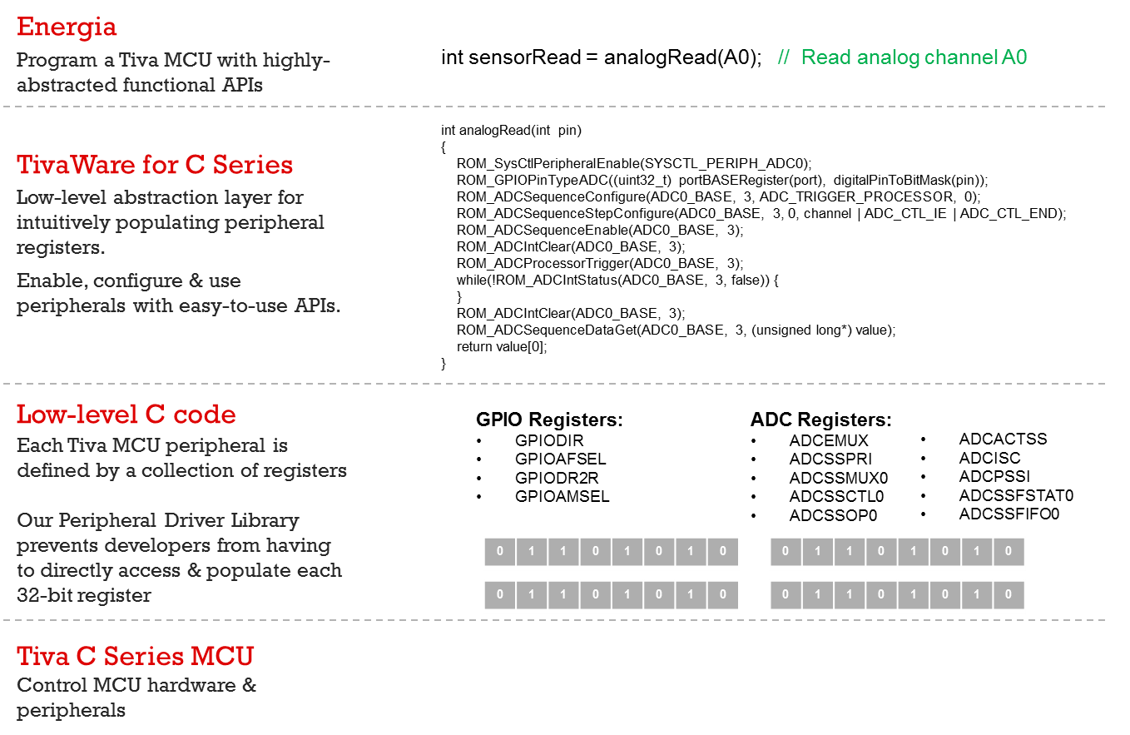

Energia Abstraction Fly high above the bits & bytes
{
1
}
Boils it down to line of code
Energia
Highly-abstracted functional APIs
Abstraction
TI Drivers // SDK
Peripheral Driver Library
Low level abstraction layer for populating peripheral registers
Low-level C Code
Each TI microcontroller peripheral is defined by a collection of registers
TI Microcontroller
Control MCU hardware & peripherals
7

Slide 8
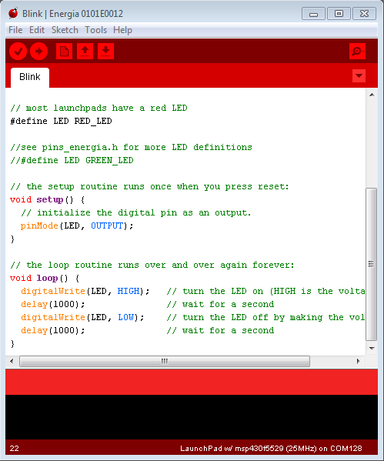
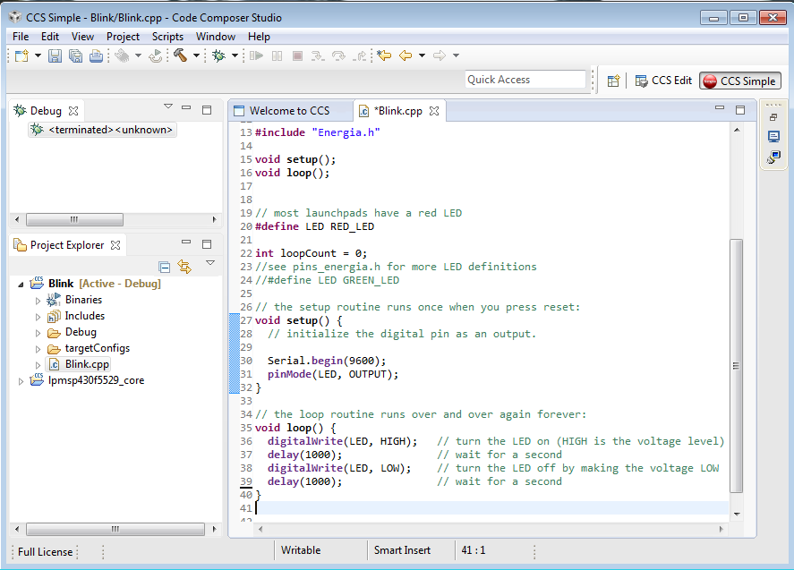
Energia Import in CCSv6+ and CCS Cloud
Import an Energia sketch into Code Composer Studio v6/v7/v8 & pick up right where you left off.
CCS introduces full debug capability & other professional features to further optimize your design.
Modularize your code & leverage Energia APIs & libraries within CCS
Enable “hybrid” projects that leverage low-level C, assembly & even abstracted Energia APIs enabling a developer maximum flexibility during code development.

Slide 9
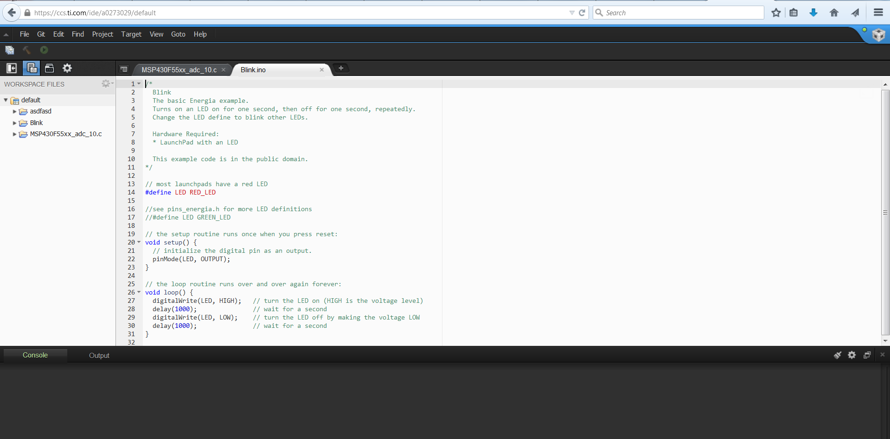
Code Composer Studio Cloud
Browser based code editing tool to get your started quickly
Access Resource Explorer to get the latest code examples, design files, and more.
Cross Platform and allows you to upload firmware using TI Cloud Agent + Browser Extension
Extended Debugging capability
http://dev.ti.com

Slide 10
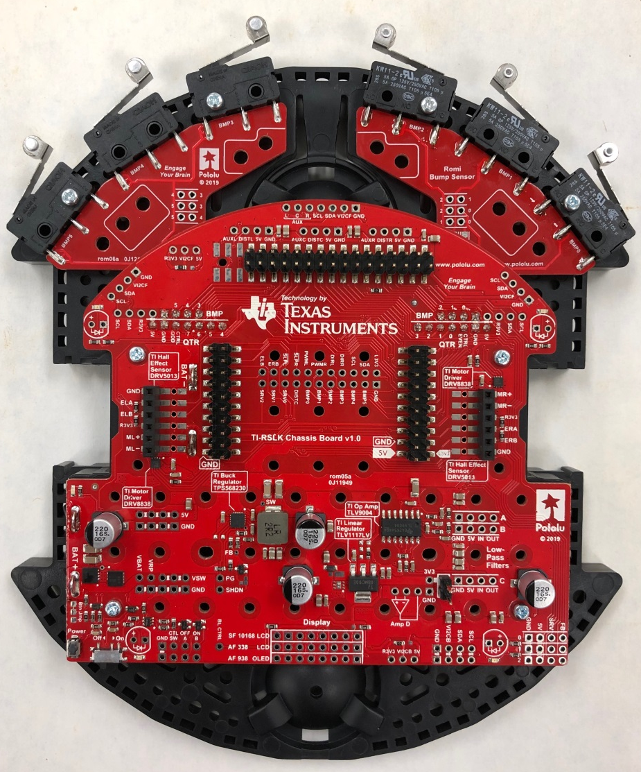
Solderless TI-RSLK Overview
Partnership with Pololu.com
Romi Plastic Chassis
Romi Motors/mounts/encoders
Romi PCBs
Bump Switches Board
Line Following Sensor Board (under side)
TI Electronics
Microcontroller brain = MSP432P401R LaunchPad
Motor Drivers = DRV8838 (x2)
Hall Effect Sensors for Encoders = DRV5013 (x4)
5V output Switching Regulator = TPS568230
4-channel Operational Amplifier = TLV9004
3.3V output Linear Regulator = TLV1117LV

Slide 11
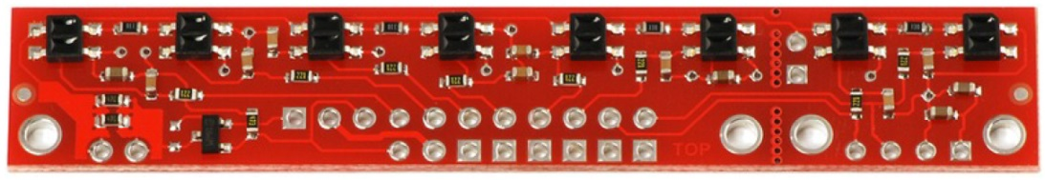
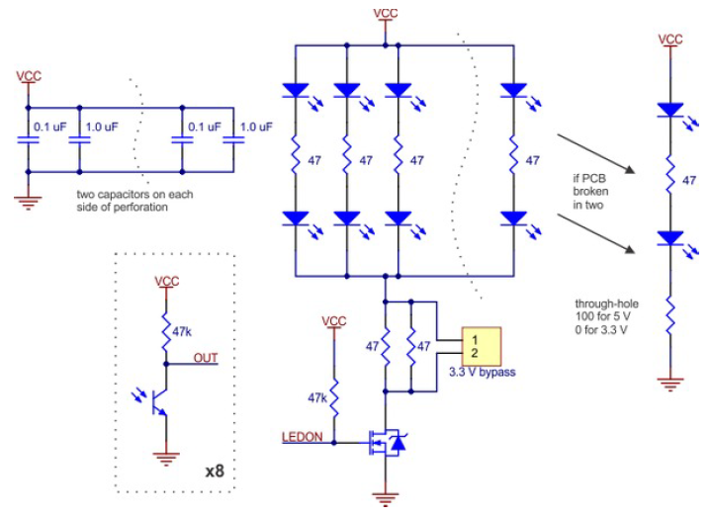
Line Following Sensor Bar
QTR-8RC
8 Infrared transmitter/receiver pairs
1 FET transistor to turn on Infrared LED transmitters
1 Resistor/Capacitor pair on each “OUT” signal
Allows for use of timers/GPIOs vs ADCs
You’ll learn about this during the course =)
Receivers will produce different voltages
and/or rise and fall times
depending on reflectivity of surface (line)

Slide 12
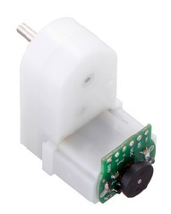
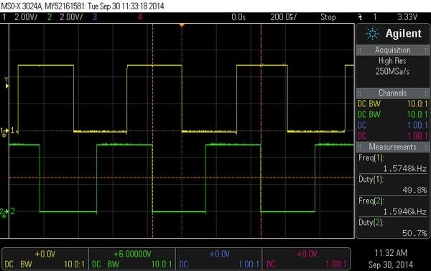
Gearmotor and Encoders
Motors
120:1 gear ratio
120 rotations of small shaft/disc = 1 rotation of wheel
TI-RSLK powers these motors at battery voltage
6 AA batteries x 1.5V max each = 9V max
Encoders
Disc has 3 PN magnets = 6 poles
2 magnetic field Hall Effect sensors per board
Provides 12 states/counts per rotation (vs 6 w/ just 1)
120 gear ratio x 12 counts per rotation = 1440 counts per rotation!
11 10 00 01
11 10 00 01
11 10 00 01
1 0 1 0 1 0

Slide 13
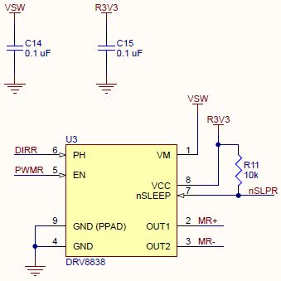
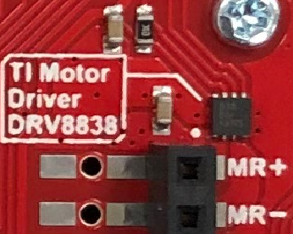
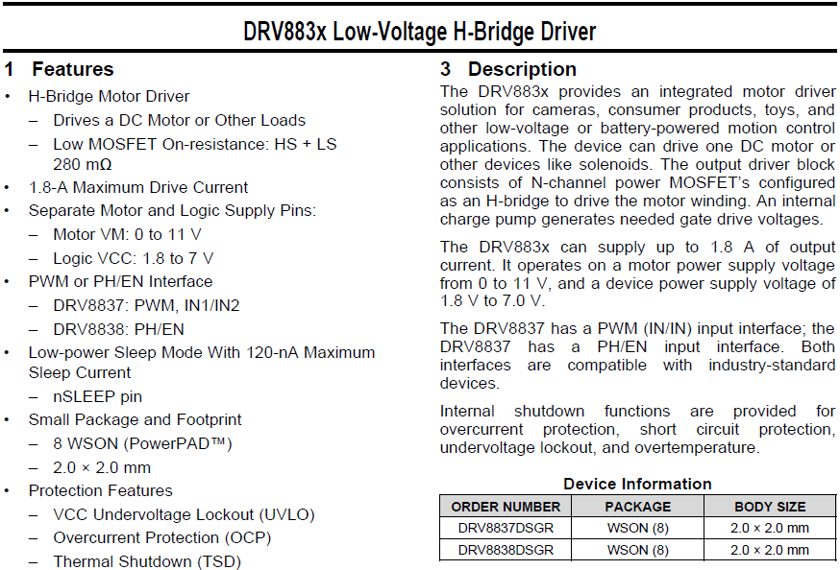
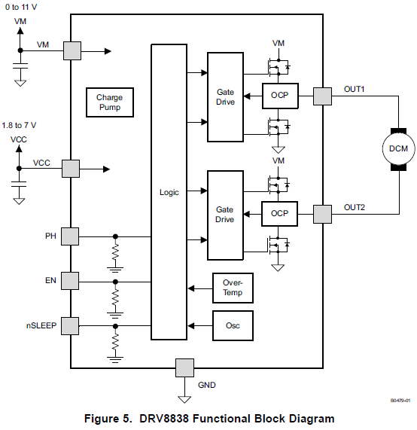
DRV8838 Motor Driver

Slide 14
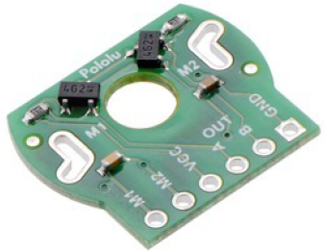
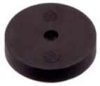
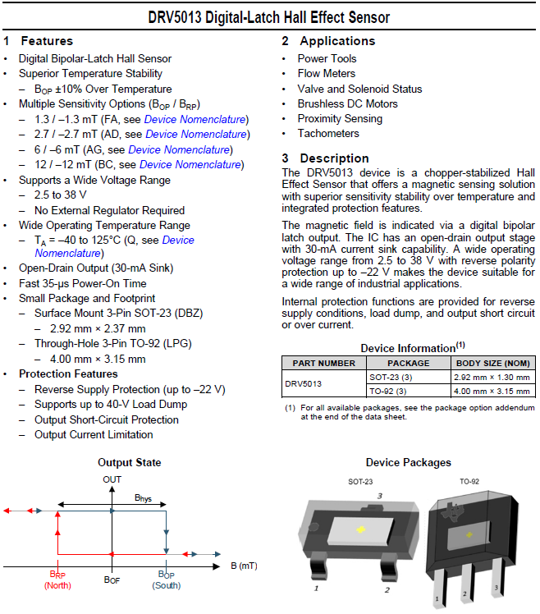
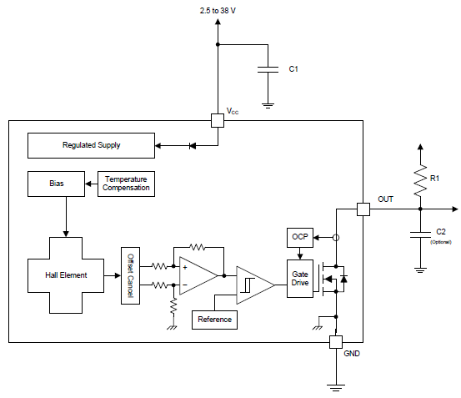
DRV5013 Hall Effect Sensor

Slide 15
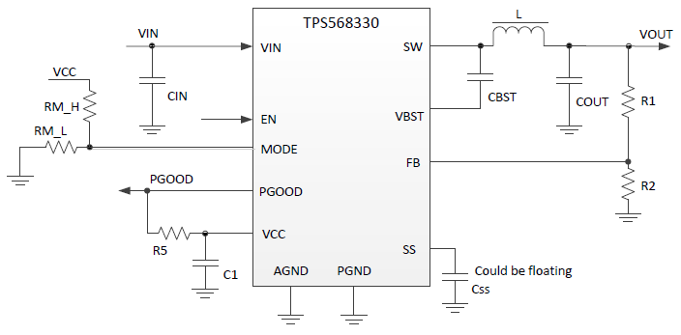
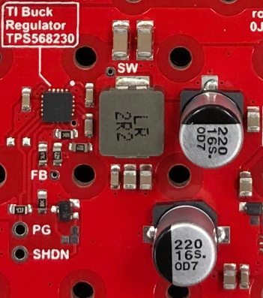
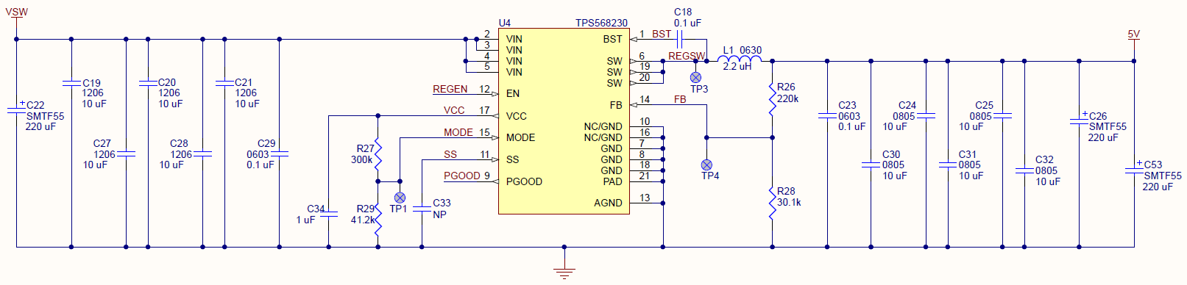
TPS568230/330 Switching Regulator = 5V, up to 8A
Generate 5V
Feeds 3.3V
Future “Extras”
LCD/OLED display
Distance Sensors
Other sensors

Slide 16
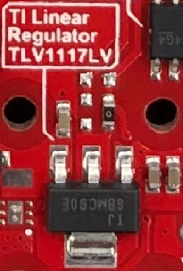
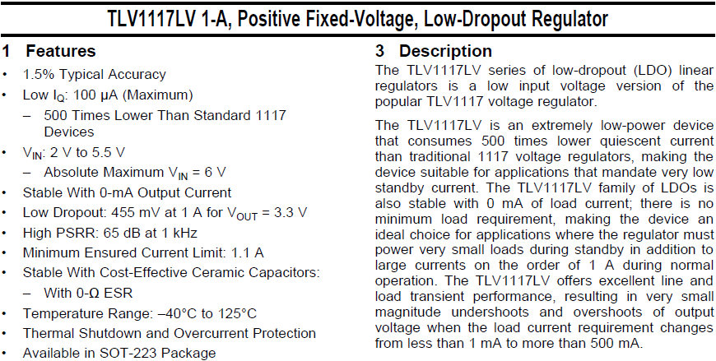
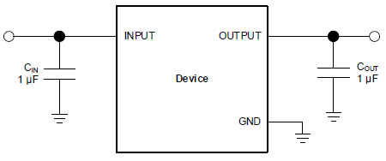
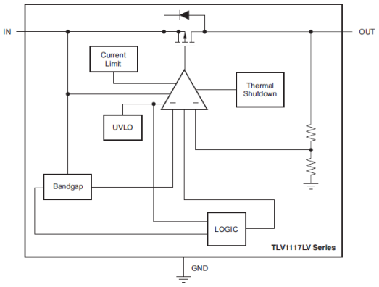
TLV1117LV Linear Regulator = 3.3V, up to 1A
3.3V output for MSP432 LaunchPad, etc.

Slide 17
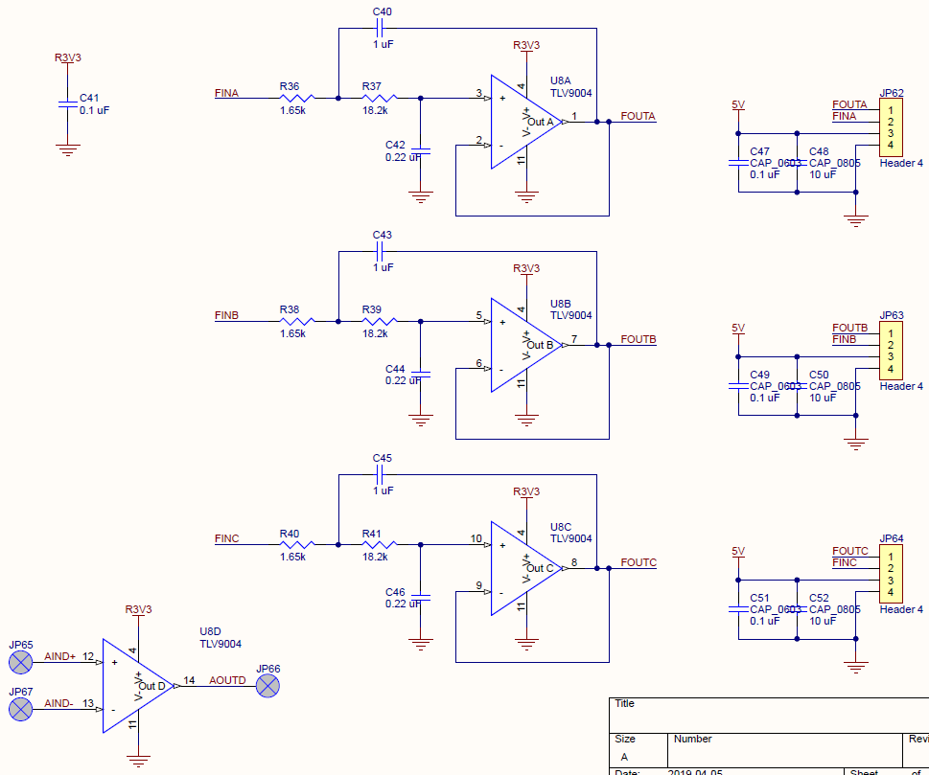
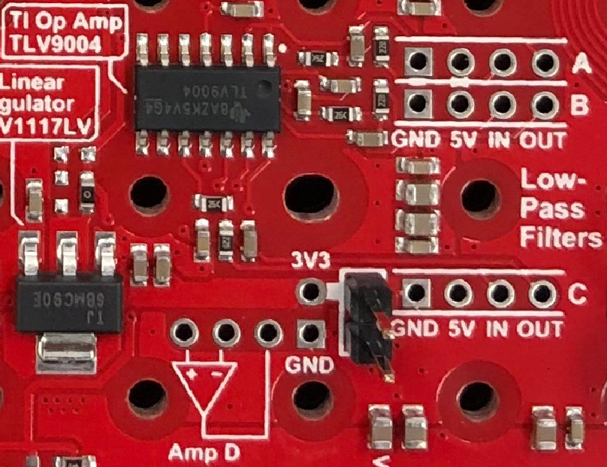
TLV9004 4-channel Operational Amplifier
For Distance Sensors (or other)

Slide 18
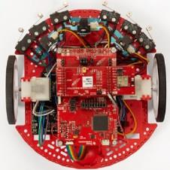
RSLK Accessories and Roadmap
Existing
Planned (2019)
Investigating:
Basic Kit includes: Bump Switches (6),
Line Following IR sensor bar,
2 Brushed Motors/Driver/Gearbox
(Embedded Systems, Intro to ENGR/EE)
Gripper Arm w/ 3 Servos
and Analog Position Feedback
(Control Systems)
Audio control board
(Analog, DSP)
Available “Advanced Kit” options:
IR Distance Sensors (3x),
Motor Shaft Encoders (2x),
LCD panel,
Bluetooth BoosterPack, WiFi BoosterPack
(Embedded Systems, C Programming,
Controls, IoT, Swarm Robotics)
mmWave Radar, WiFi streaming
(RF, Imaging, DSP,
Communications)
Alternative Energy Sources
Battery, Solar, Harvesting
(Intro to Power/Energy)
RGB camera
(Embedded Systems, Imaging)
Self-balancing: TI-RTOS
& Multi-threading
(Control Systems)
Educational BoosterPack
with joystick, LCD, mic, buzzer…
(Embedded, C Programming, IoT, Capstone)
Solderless RSLK
(Intro to ENGR)
Energia Library Support

Slide 19
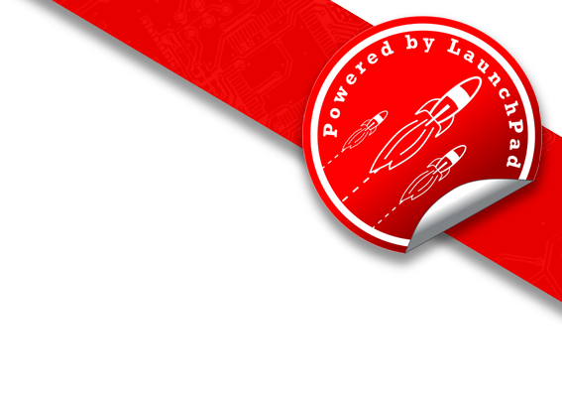
Thank you! www.ti.com/launchpad university.ti.com

